Slide 1
Image Gender Prediction and Age Estimation
BATCH-8
TEAM MEMBERS:
Nakka Anantha Lakshmi (22MH1A0540)
Thusti Nikhil (22MH1A0574)
Kelim Rajesh (22MH1A0526)
Tadi Ayyapa AmmiReddy (22MH1A0571)

Slide 2
CONTENTS :
ABSTRACT
INTRODUCTION
PROBLEM STATEMENT
SPECIFICATIONS
IMPLEMENTING PROJECT:USAGE OF TECHNOLOGIES
MODULES
CODE IMPLEMENTATION
CODE EXECUTION & OUTPUT
APPLICATIONS
CONCLUSION

Slide 3
ABSTRACT :
This project utilizes artificial intelligence and computer vision techniques to detect and classify a person's age and gender from images or video streams in real time. By employing pre-trained deep learning models integrated with OpenCV, the system identifies faces in the input and predicts demographic information such as age group and gender with high accuracy. The code can be run on both pre-existing images or live webcam feeds, making it flexible for various applications. The simplicity of its implementation, combined with the power of AI, offers numerous practical uses across industries like retail analytics, security, healthcare, and marketing.

Slide 4
INTRODUCTION :
This project combines computer vision and deep learning for a practical application of gender and age detection using artificial intelligence.The goal is to detect faces in images or video streams and predict the age and gender of each detected face using artificial intelligence.Allows users to provide images or use live webcam for detection. Displays predictions (gender and age) on the image or video feed and saves the processed images.It develop a system for real-time detection of gender and age using artificial intelligence.Detects human faces in images or through webcam feeds.Classifies gender (Male/Female) and predicts age range (e.g., 0-2, 25-32, 60-100) for each detected face.
Technology Used:OpenCV for image processing.Pre-trained deep learning models for face detection, gender classification, and age prediction.

Slide 5
PROBLEM STATEMENT :
In today's world, automated systems that can understand human features are becoming increasingly important for various applications like security, user profiling, and targeted marketing.
However, identifying a person's age and gender accurately from an image or video in real time is a challenging task.
This project addresses the following problem:
Face Detection
Gender Prediction
Age Prediction
Real-Time Performance

Slide 6
SPECIFICATIONS :
Hardware Requirements:
Computer System:
Processor: Intel i5 or higher (or equivalent AMD processor)
RAM: Minimum 8 GB (16 GB recommended for smoother performance)
Storage: At least 10 GB of free disk space for software, models, and output images
Graphics Card: NVIDIA GPU (recommended for better performance with deep learning tasks, especially if using larger models)
Camera (for real-time detection):
Webcam: Any standard USB webcam with at least 720p resolution
Optional: High-definition webcam or camera for improved image quality

Slide 7
Software Requirements:
Operating System:
Windows 10 or later, macOS, or Linux (Ubuntu 18.04 or later)
Programming Environment:
Python: Version 3.6 or later
Libraries and Frameworks:
OpenCV: For computer vision tasks (install via pip: pip install opencv-python)
NumPy: For numerical operations (install via pip: pip install numpy)
argparse: For command-line argument parsing (comes pre-installed with Python)
Caffe: For loading and using pre-trained models (may require additional setup)

Slide 8
Model Files:
Download the following model files:
opencv_face_detector.pbtxt and opencv_face_detector_uint8.pb (for face detection)
age_deploy.prototxt and age_net.caffemodel (for age detection)
gender_deploy.prototxt and gender_net.caffemodel (for gender detection)
Development Environment:
An Integrated Development Environment (IDE) or code editor such as:
PyCharm
Visual Studio Code
Jupyter Notebook (for experimentation)

Slide 9
Implementing Project: Usage of Technologies
Programming Language:
Python: The primary language used for development due to its extensive libraries and frameworks for computer vision and machine learning.
Computer Vision:
OpenCV: A powerful library used for real-time computer vision applications.
In this project, it is utilized for:
Face detection using pre-trained models.
Image manipulation and drawing rectangles around detected faces.
Displaying results in real time.
Command Line Interface:
argparse: A Python module used for parsing command-line arguments, allowing users to specify input images or use the webcam for live detection.

Slide 10
Deep Learning Framework: DNN (Deep Neural Network) module in OpenCV: Loads pre-trained Caffe models for age and gender classification. Processes images through the network to obtain predictions.
Image Processing Techniques:
Blob Extraction: Converts images to a format suitable for deep learning models, adjusting size and normalization.
Bounding Boxes: Draws rectangles around detected faces for better visualization and results interpretation.
Real-Time Video Capture:
cv.VideoCapture: Used to access video files or webcam streams, facilitating live analysis and interaction with users.

Slide 11
MODULES :
1. Data Collection and Preprocessing Module
opencv-python: For image processing (resizing, cropping, etc.) and handling image formats.
For face detection using pre-trained Haar cascades or DNN modules.
pip install opencv-python
numpy: For handling arrays and numerical operations on image data.
pip install numpy
pandas: For managing datasets (labels, paths, etc.).
pip install pandas
2. Face Detection Module
mtcnn: For detecting faces and facial landmarks in images.
pip install mtcnn

Slide 12
dlib: For facial detection, tracking, and face alignment.
pip install dlib
tensorflow or pytorch: For using YOLO or SSD models for face detection.
pip install tensorflow # For TensorFlow
pip install torch # For PyTorch
3. Gender Classification , Feature Extraction and Age Estimation Module:
scikit-learn: For any additional feature extraction or preprocessing tasks.
pip install scikit-learn
tensorflow/keras: For building and training neural networks for gender classification.
pip install tensorflow keras scikit-learn
4. Evaluation and Testing Module
matplotlib or seaborn: For visualizing confusion matrices and performance metrics.
pip install scikit-learn matplotlib seaborn

Slide 13
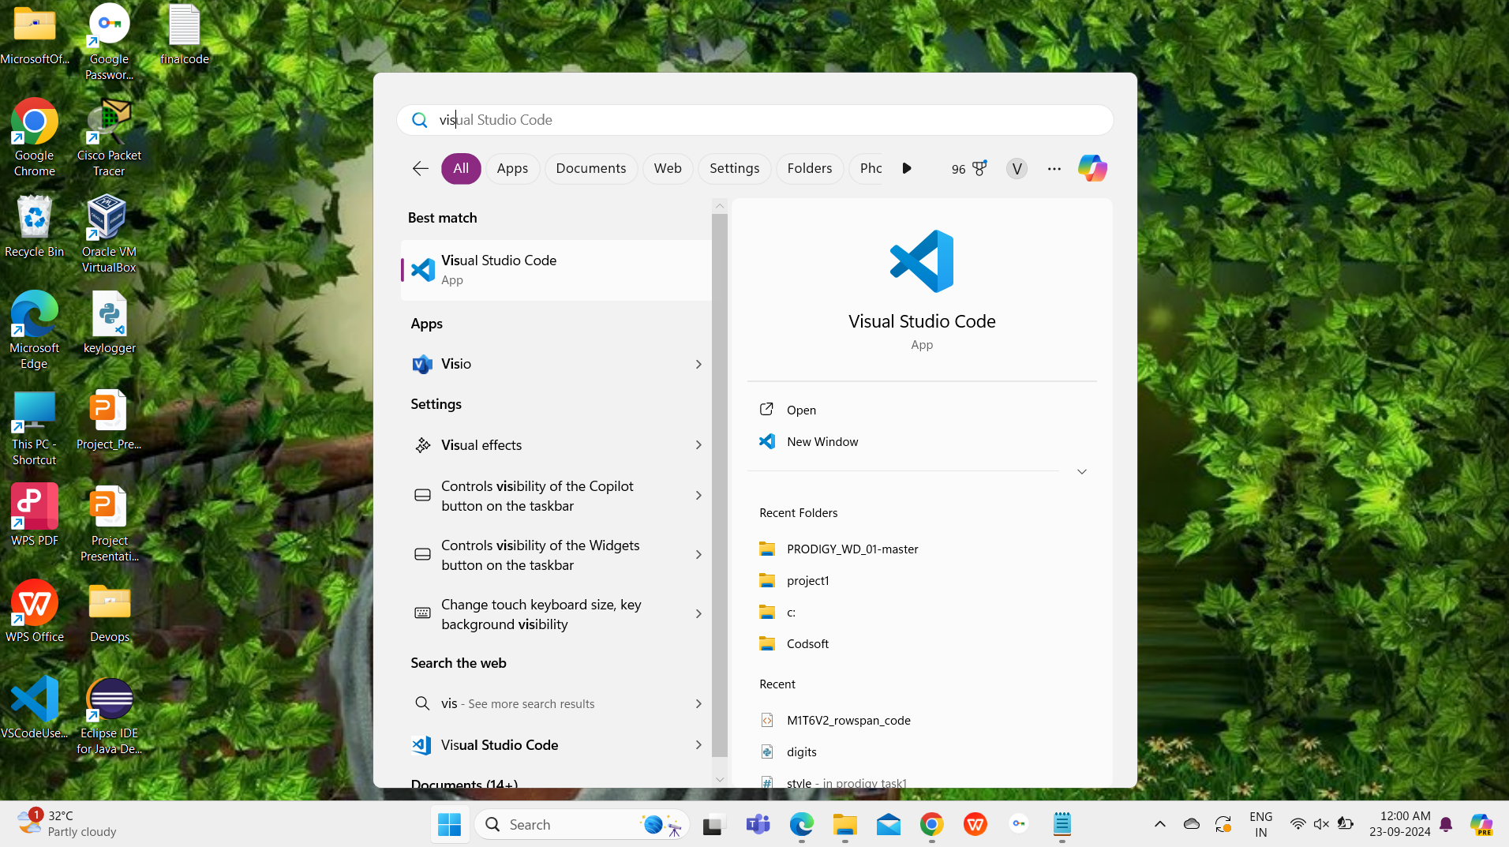

CODE IMPLEMENTATION :
First open Visual Studio Code App.

Slide 14
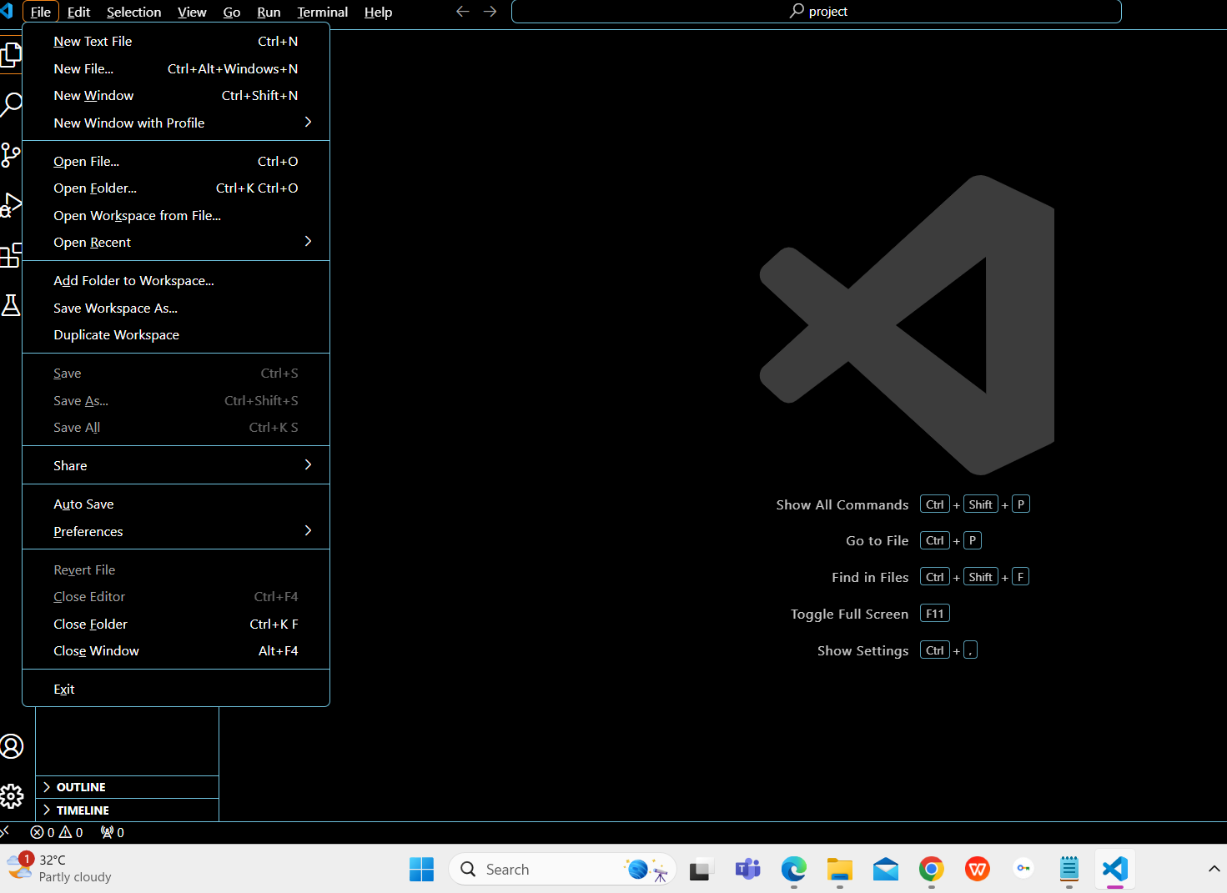
First go file option in menu .
Next click on open folder.

Slide 15
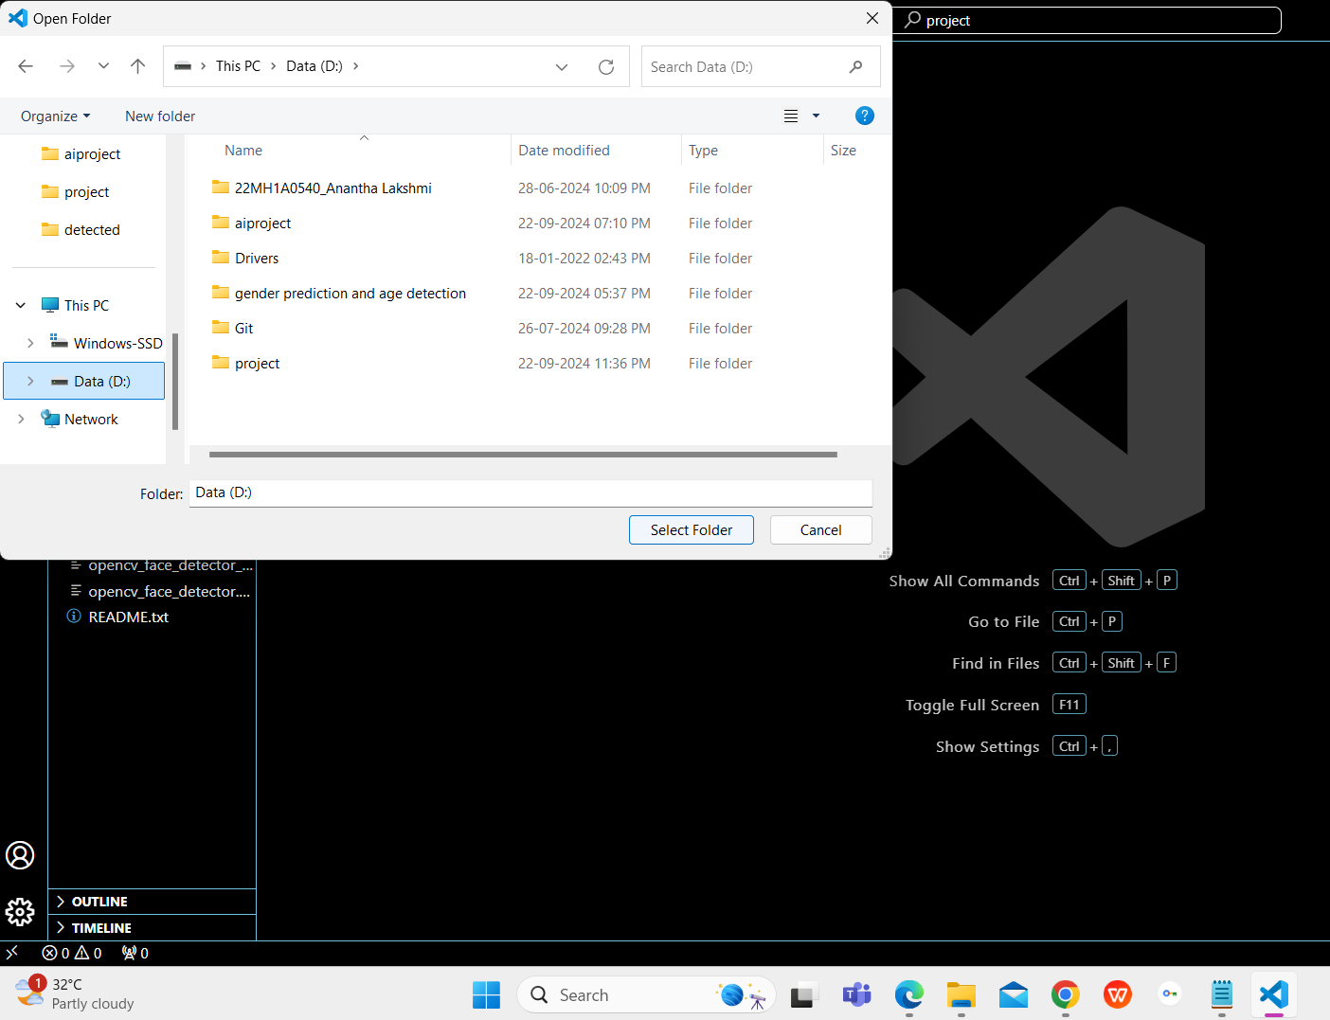
Go to D drive and click on project folder.
Then click on select folder option.

Slide 16
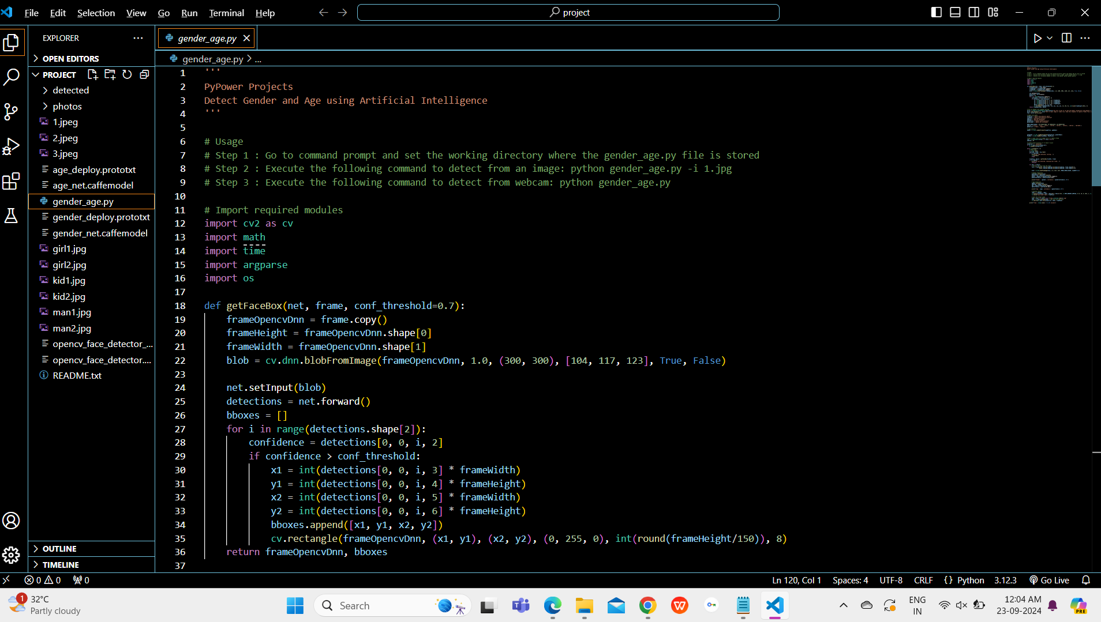
Go to gender_age.py python code file and open it.

Slide 17
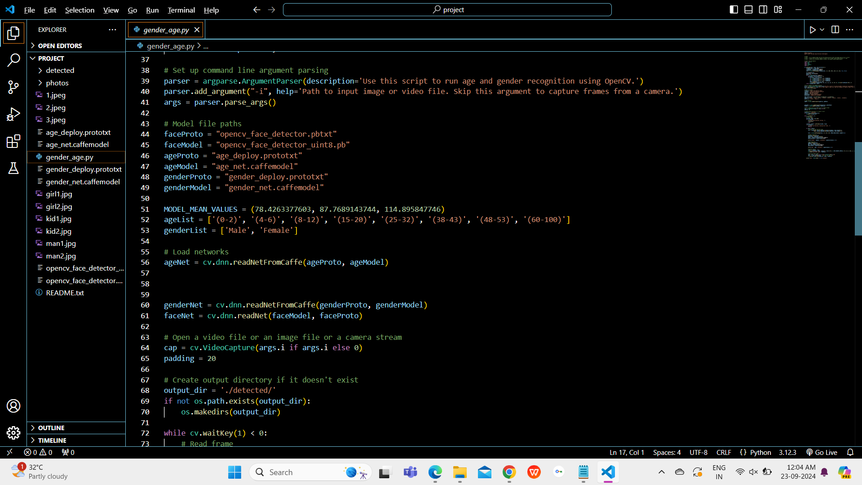

Slide 18
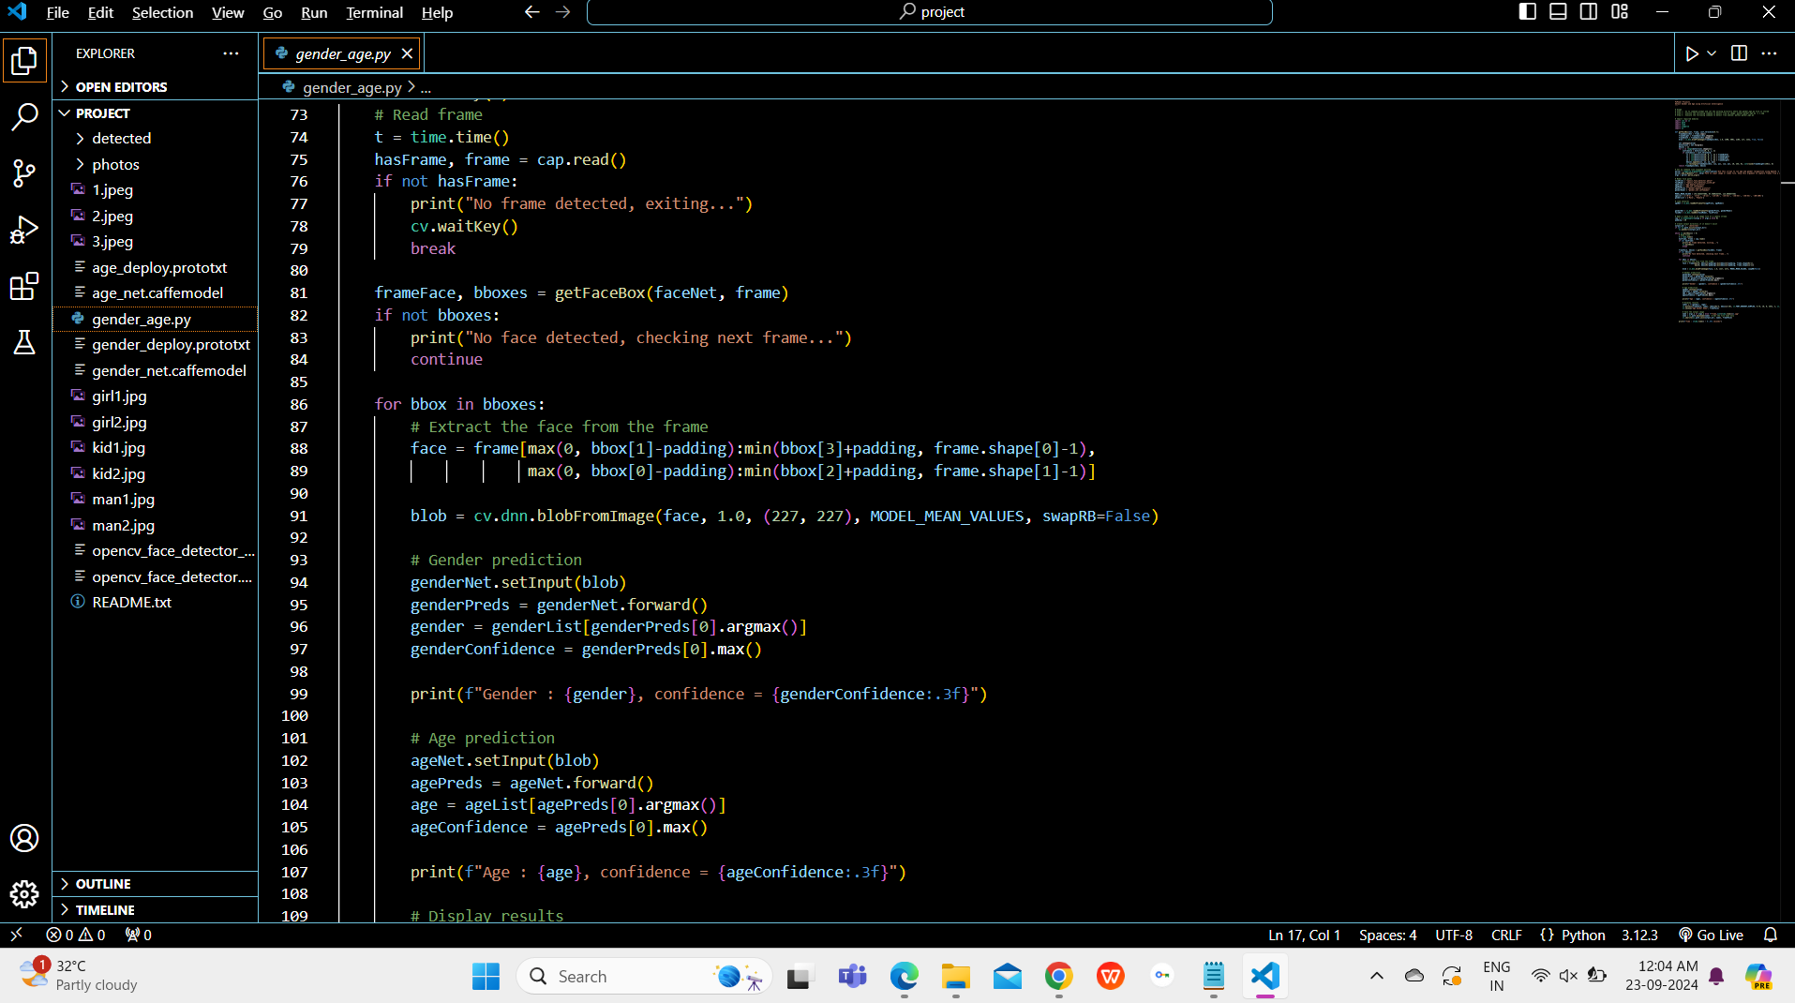
Click on run symbol.

Slide 19
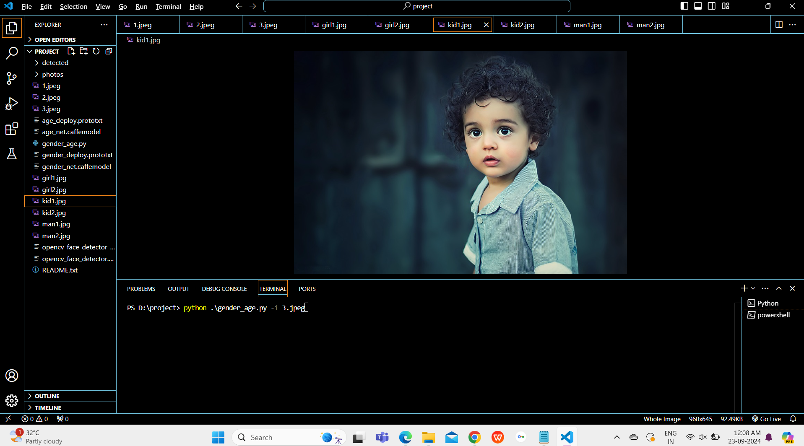
Open the terminal window in powershell.

Slide 20
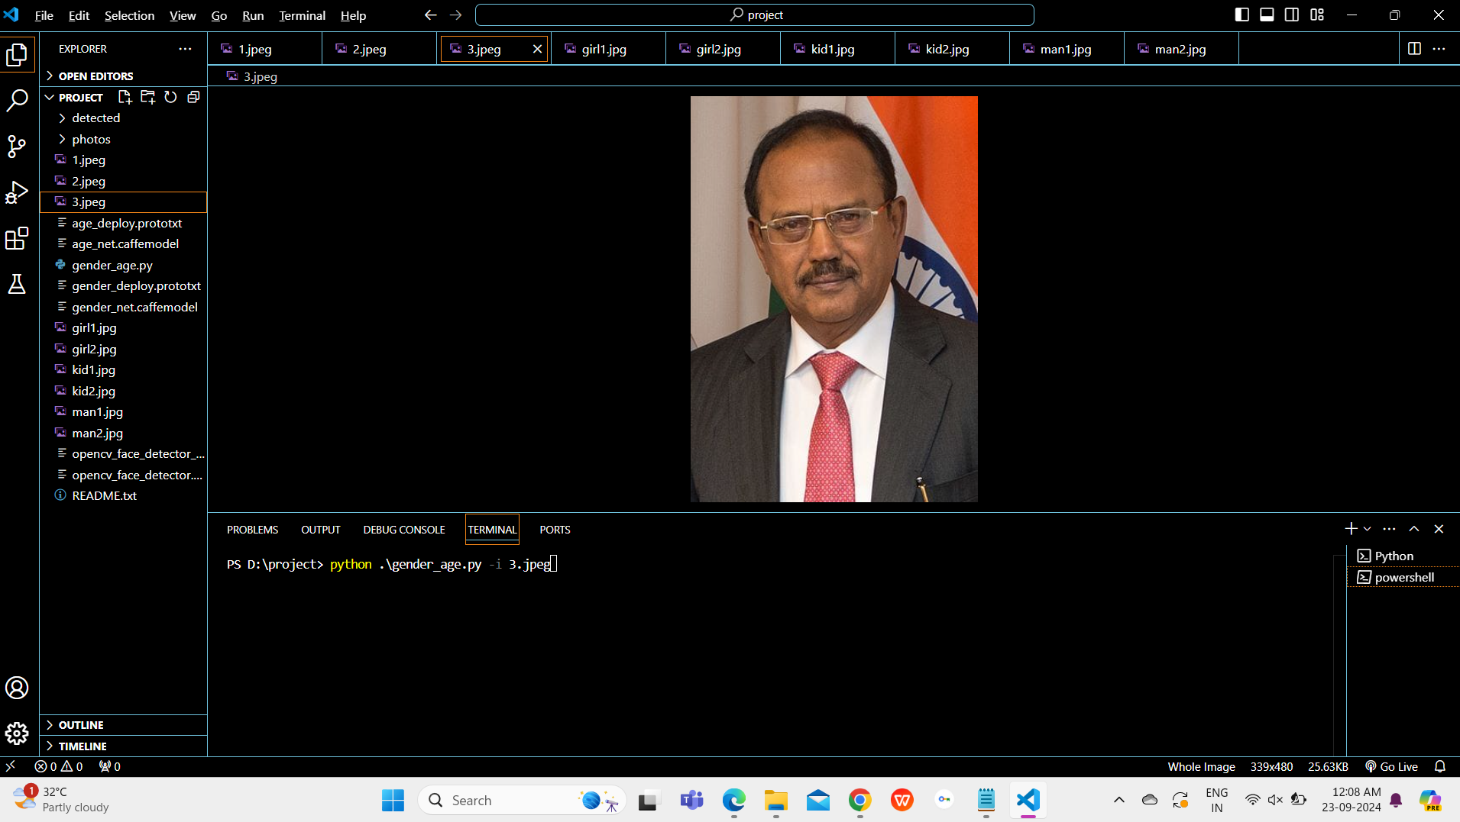
CODE EXECUTION :
Then in terminal window give command as python .\gender_age.py -i image name.

Slide 21
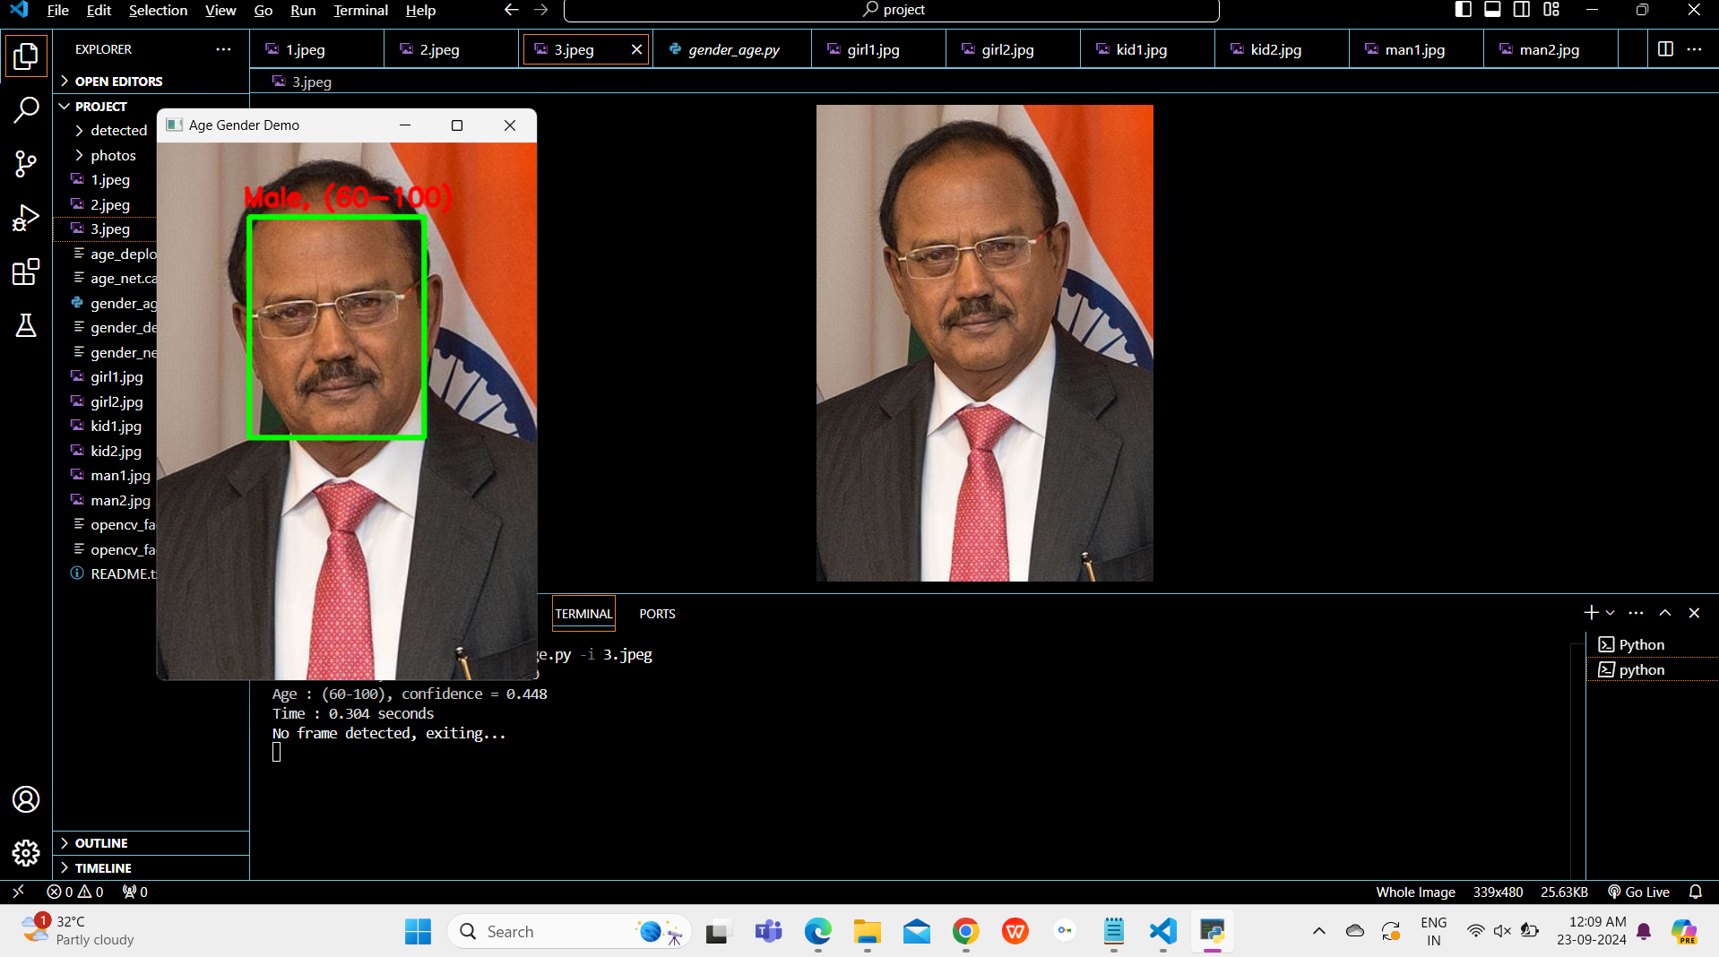
OUTPUT :

Slide 22
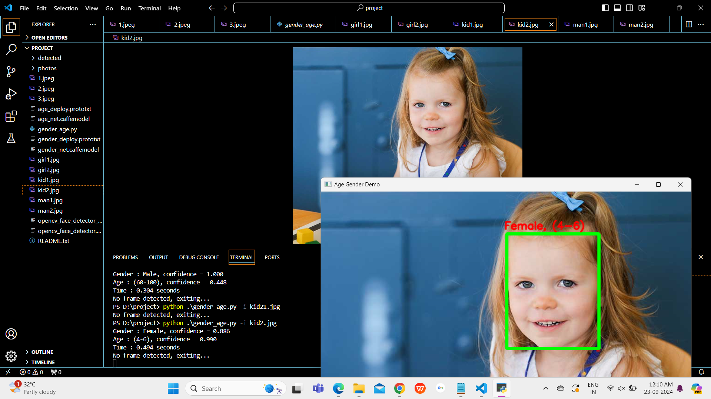

Slide 23
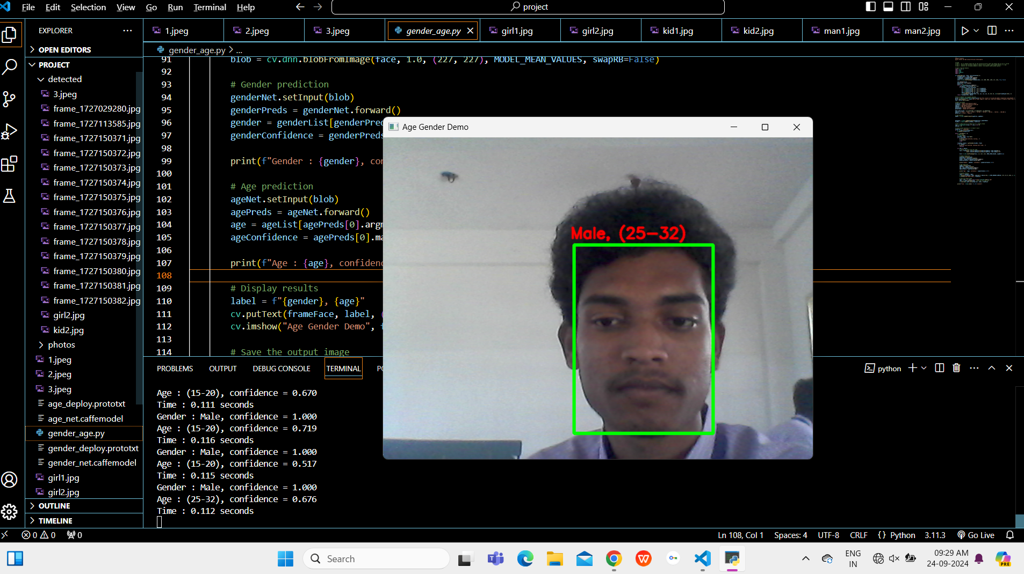
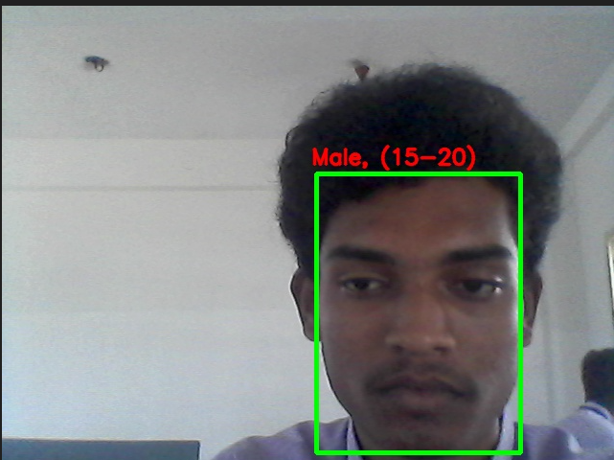
To get web cam give python .\gender_age.py as command in terminal window
Face detected ,gender and age predicted through WEB CAM.

Slide 24
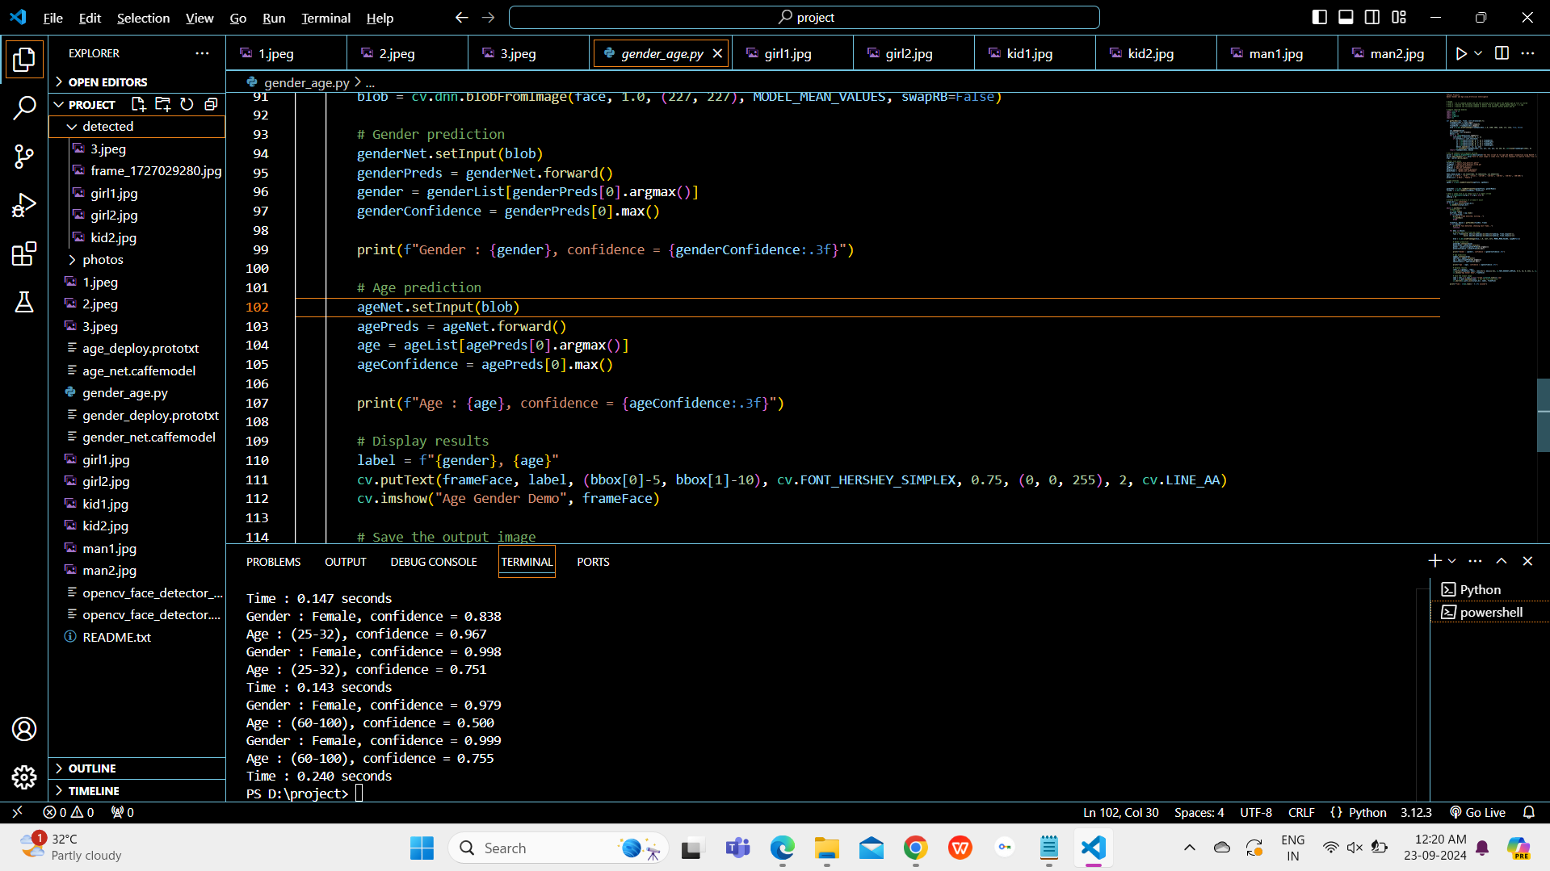
All the detected images are in Detected folder.

Slide 25
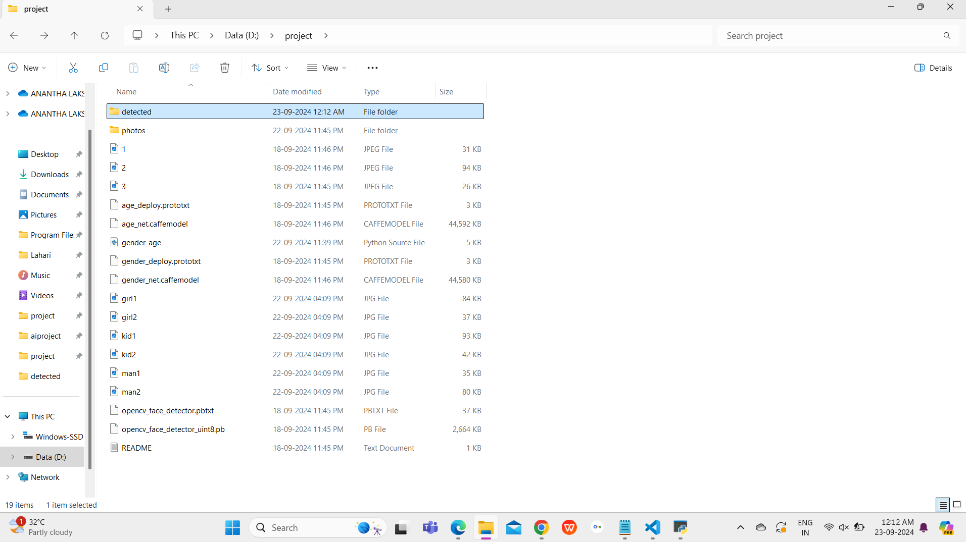
Go to detected folder to get detected images.

Slide 26
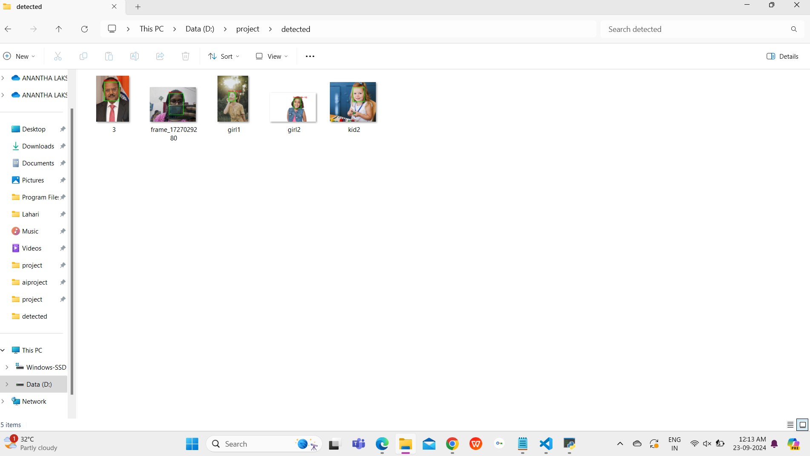
All the detected images.

Slide 27
APPLICATIONS :
Retail Analytics: Analyze customer demographics for targeted marketing.
Social Media Filtering: Recommend content based on user age and gender.
Security Surveillance: Monitor demographics in security footage.
Telemedicine: Prepare healthcare providers for virtual consultations.
Marketing Research: Gather insights on target audiences for product development.
Gaming Personalization: Tailor gaming experiences based on player demographics.
Event Management: Optimize event planning with attendee demographic analysis.
Education Tools: Adapt teaching strategies based on classroom demographics.

Slide 28
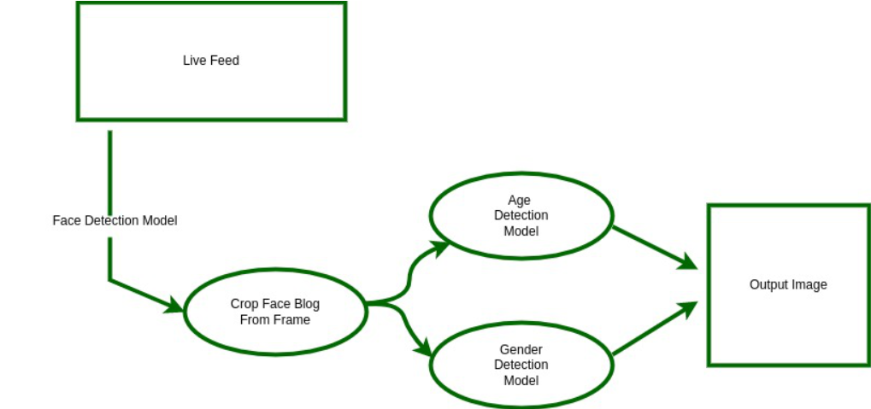
CONCLUSION :
Finally code successfully detects age and gender using AI and OpenCV.
It can analyze images or video streams in real time, making it useful for various applications like marketing, security, and personalized experiences.
By identifying demographics, businesses and organizations can better understand their audience and improve their services.
This project serves as a solid starting point for anyone interested in exploring how AI can be used in everyday situations.

Slide 29


